Slide 1
GÖBEKLİ TEPE THE WORLD’S OLDEST AND BİGGEST TEMPLE

Slide 2
ZERO POINT IN TIME

Slide 3
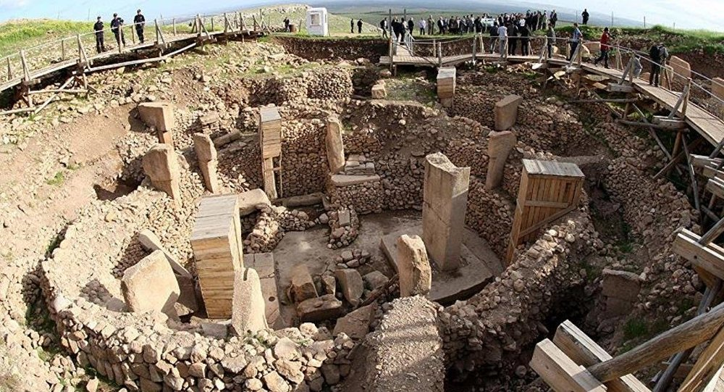
STAGE OF HISTORY CHANGED !

Slide 4
History changed… The first temple…
Located on a hill , South eastern province of Şanlıurfa, the ancient site of Göbeklitepe has archeological findings important enough to change the history of the world.
As the world’s oldest and biggest temple, it has even been reputed as the place where history began. A ritual centre from 12 thousand years ago, an archeological treasure yet to be fully discovered.It is listed by UNESCO as a World Heritage Site.

Slide 5
The site is the oldest man-made place of worship yet discovered, dating back to 10,000 BCE. The temples were discovered by a German archeologist (Klaus Schmidt)
GOBEKLI TEPE IS THE OLDEST MAN-MADE PLACE OF WORSHIP YET DISCOVERED, DATING BACK TO 10,000 BCE.

Slide 6
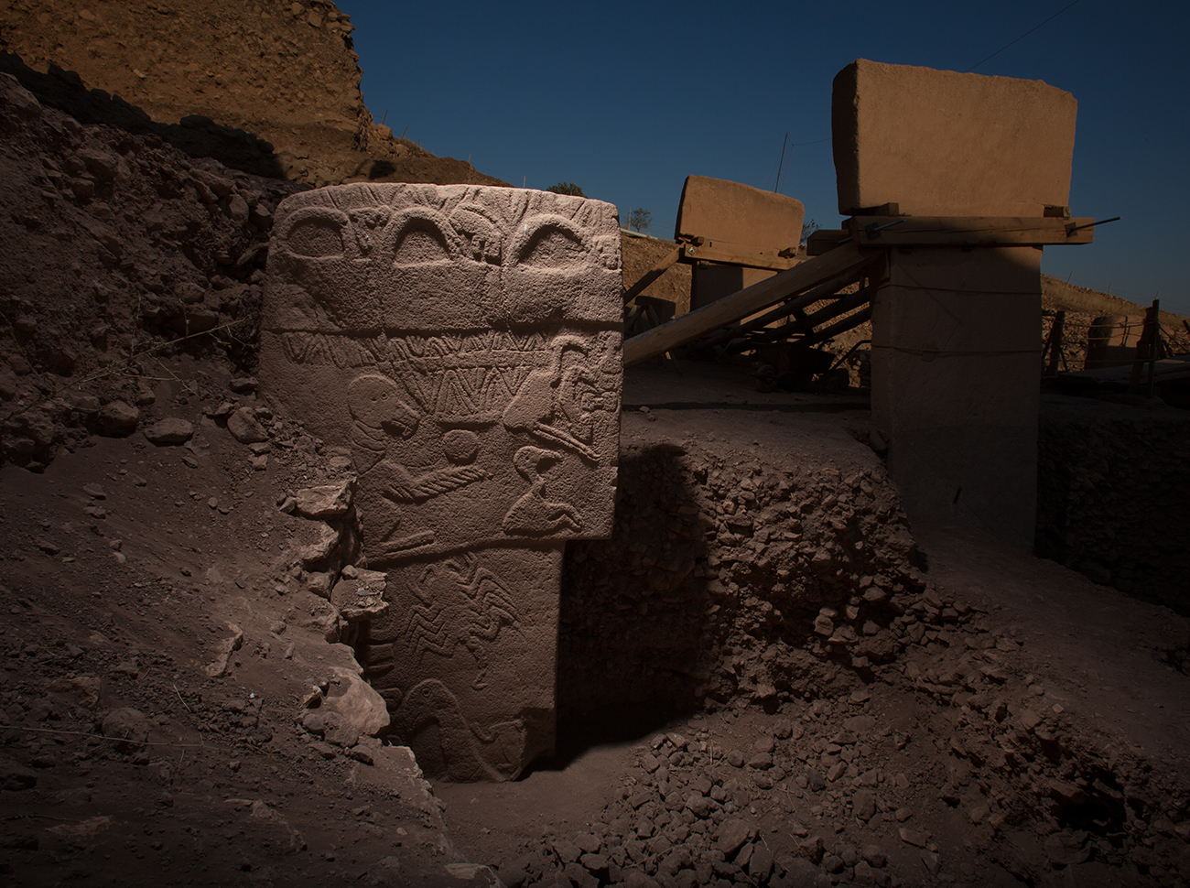

Slide 7
