Slide 1
ISTITUTO COMPRENSIVO ATRI
ATRI COMPREHENSIVE INSTITUTE
Viale Umberto I n.3 – 64032 Atri (Te)
Tel. 0039 08587265 - 08587506
Website: icatri.edu.it
Headteacher: Professor Achille Volpini

Slide 2
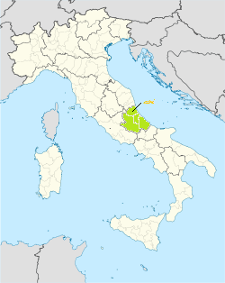
Our school is situated in Atri, a lively town in Central Italy, in the Abruzzo region.

Slide 3
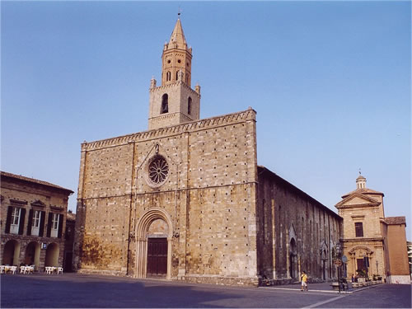
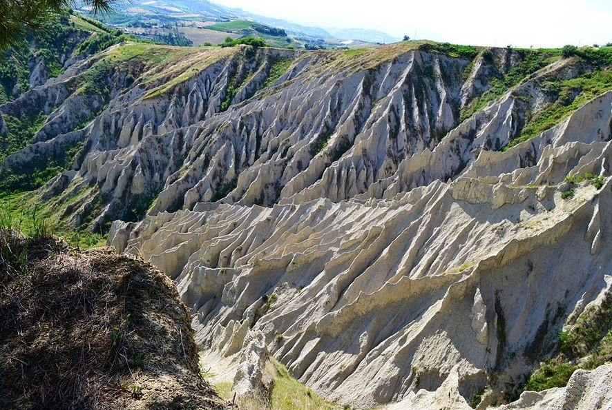
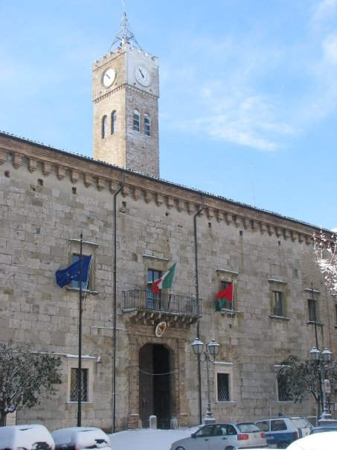
Our Town
The Cathedral
The «Calanchi»
The Town Hall
Atri is a very beautiful ancient town in the heart of the Abruzzo Region.
Situated 450 meters above the sea level, with a population of 11,500 inhabitants, this lively heritage site is home to fascinating historic places, colourful events, suggestive landscapes and corners.

Slide 4
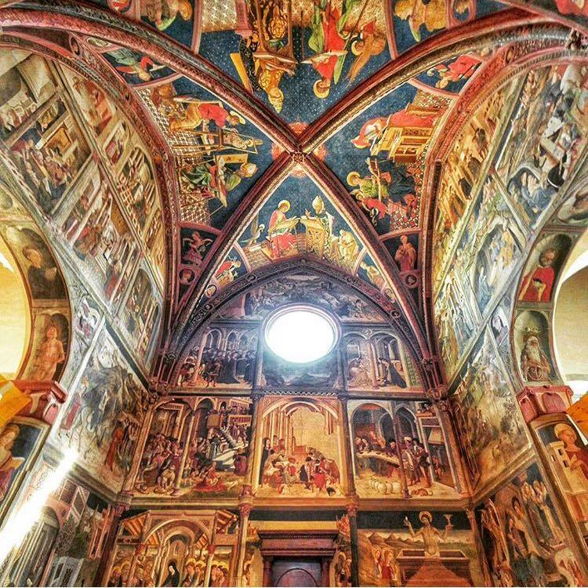
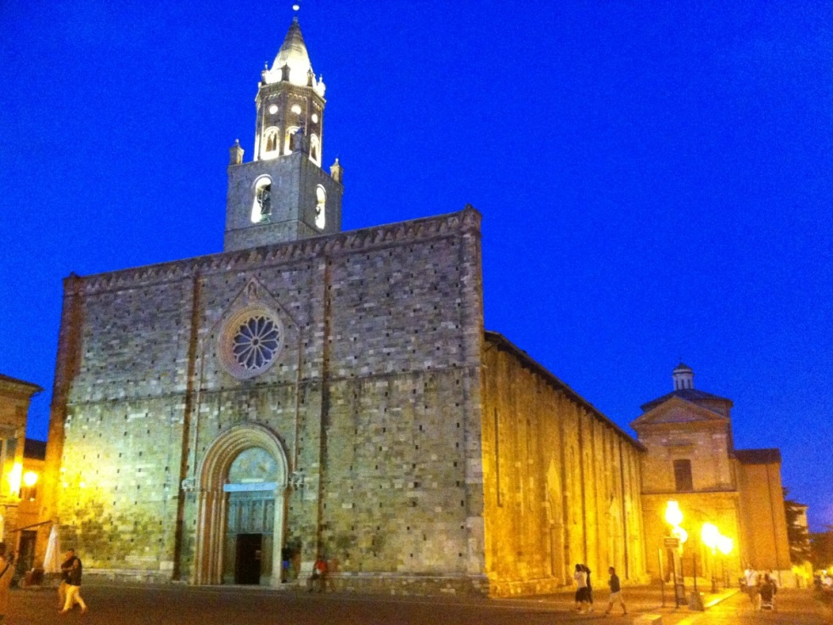
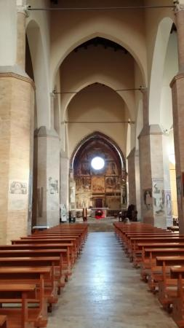
The Cathedral
It is a superb square church and a precious example of the Romanesque style. The large interior with its 3 naves, hosts extraordinary treasures,
Saint Mary’s Cathedral, is one of the most important example of the Romanesque period in the Abruzzi region. It was consacreated in 1223 but rebuilt so many times
Its masterpiece is the choir decorated with the frescoes by Andrea De Litio. It is considered the largest work of art of the first period of the Renaissance.

Slide 5
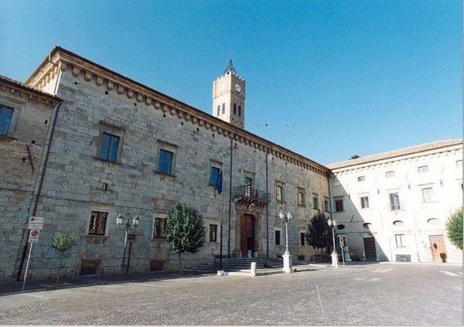
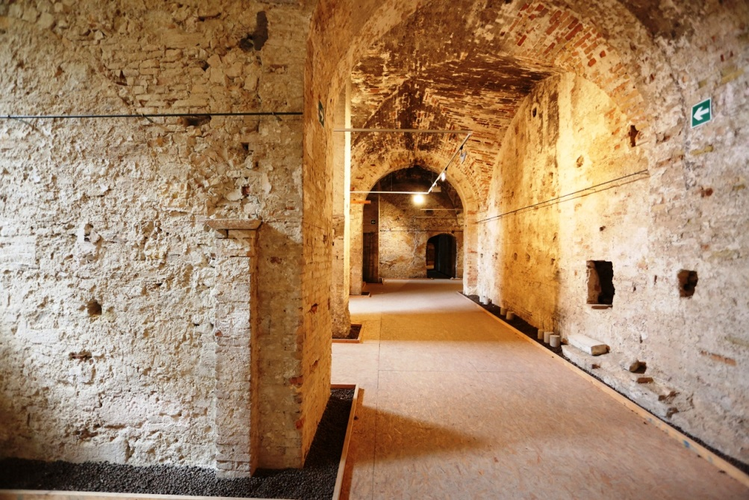
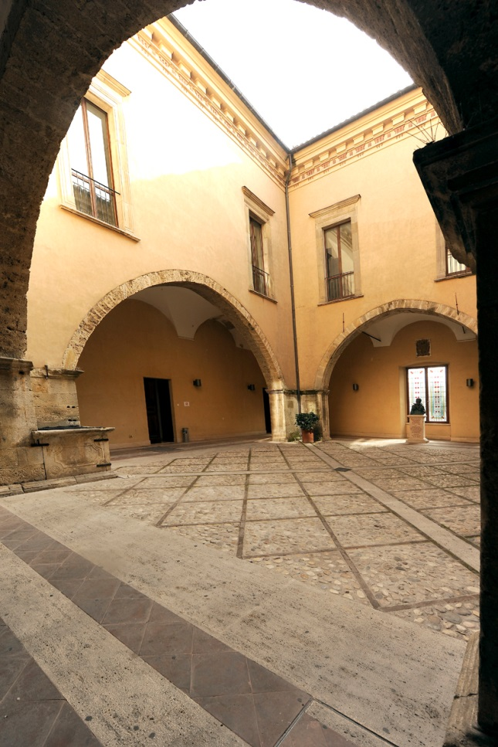
The Town Hall
The courtyard, with its arcades, it’s an architectural gem. All around it you can see several inscriptions dating back to the Roman period and also a coffin of the myth of Dionysus.
The Ducal Palace was built at the end of 1300 with the stones from the ancient megalithic walls of the town of Atri. Today it houses the Town Hall.
The basement, old Roman bath in the II and in the III centuries, during the Middle ages it was used as prisons and then as stables , it still preserves a Romanesque plaster and a fresco of the Nativity dating back to the XVII centrury.

Slide 6
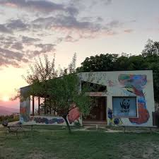
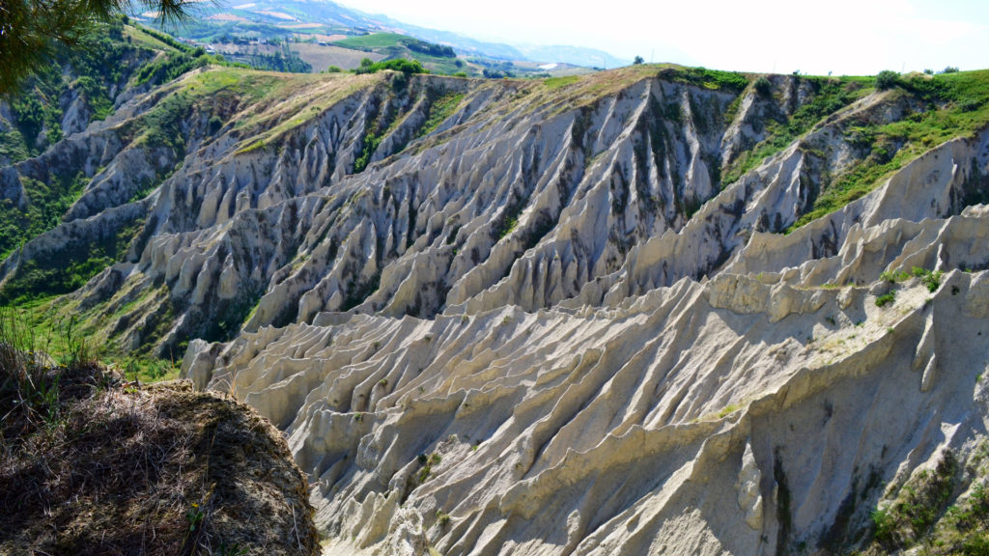
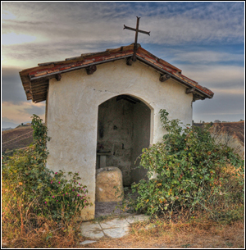
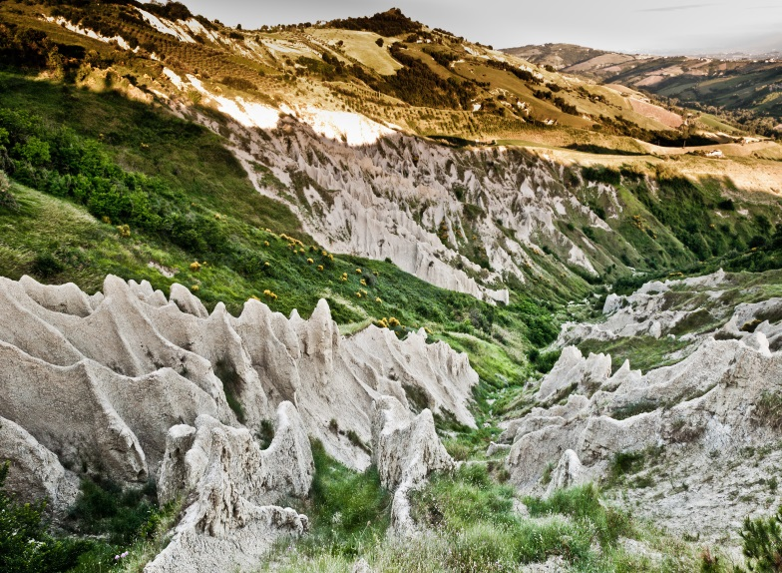
The «Calanchi»
The «Riserva Naturale Regionale Calanchi di Atri» became a WWF site in 1999, its purpouse is to protect about 600 acres of nature, flora and fauna.
This area is characterized by form of erosion called : i Calanchi «Bad lands» in English. Their features of biodiversity and geological diversity give a unique view to the agricultural landscape. The impressive natural forms are also known as «Dante Alighieri’s Bolge» or «The Devil’s Fngernails».
SAINT PETER’S STONE (SANDE PÀULE):
At the Oasi dei Calanchi you can see this stone which is linked to faith, legend and history. It is a monolith 1 meter high, it is the rest of a pre-christian altar where travellers and merchants used to have a rest and to pray theirs gods.

Slide 7
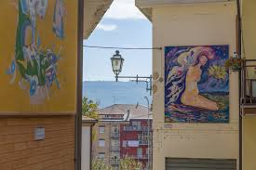
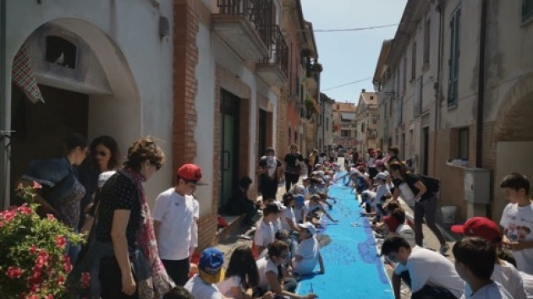
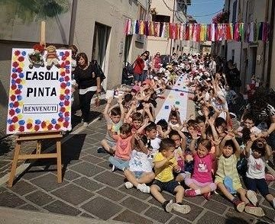
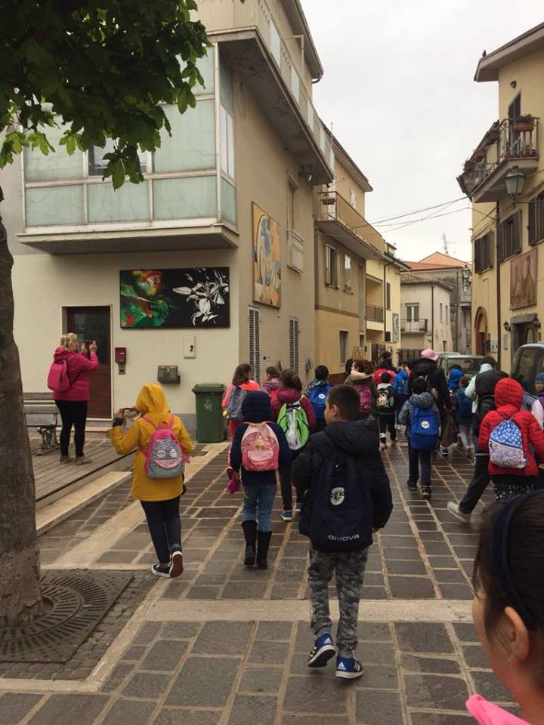
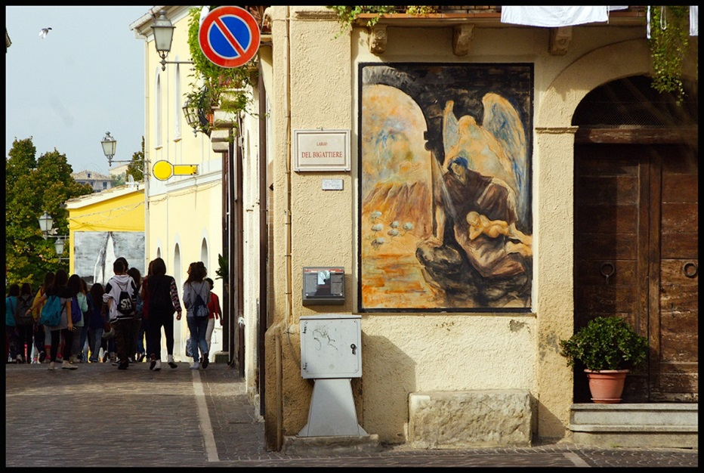
«Casoli Pinta» is a constantly evolving painting workshop. A place where students can meet the artists and can freely experience all kinds of art.
The charming village of Casoli dates back to the Roman period. From 1996 to 2001 the village has hosted an exhibition of mural paintings called “Casoli Pinta - museo sotto le stelle” (a museum under the stars). This event has turned Casoli into an artistic village.

Slide 8
