Slide 1
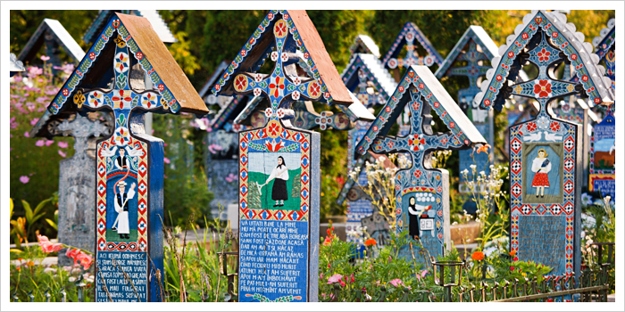
Merry Cemetery
The Merry Cemetery (Romanian: Cimitirul Vesel) is a cemetery in the village of Săpânța, Maramureş county, northern Romania. It is famous for its colourful tombstones with naïve paintings describing, in an original and poetic funny manner, the people who are buried there, as well as scenes from their lives. The Merry Cemetery became an open-air museum and a national tourist attraction.

Slide 2
Sighișoara
Sighișoara is a city on the Târnava Mare River in Mureș County, Romania. Located in the historic region of Transylvania, Sighișoara has a population of 28,102 according to the 2011 census. It is a popular tourist destination for its well-preserved walled old town, which is listed by UNESCO as a World Heritage Site.

Slide 3
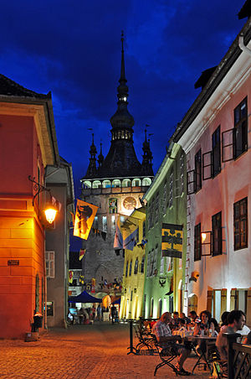
The Historic Centre of Sighișoara is the old historic center of the town of Sighișoara, Romania, built in the 12th century by Saxon settlers. It is an inhabited medieval citadel that, in 1999, was designated a UNESCO World Heritage Site for its 850-year-old testament to the history and culture of the Transylvanian Saxons.
Birthplace of Vlad III the Impaler (in Romanian Vlad Țepeș), Sighișoara hosts, every year, a medieval festival where arts and crafts blend with rock music and stage plays. The city marks the upper boundary of the Land , like its bigger brothers, Sibiu and Braşov.

Slide 4
Wooden Churches of Maramureș
The Wooden churches of Maramureș in the Maramureș region of northern Transylvania are a group of almost one hundred Orthodox churches, and occasionally Greek-Catholic ones, of different architectural solutions from different periods and areas. The Maramureș churches are high timber constructions with characteristic tall, slim bell towers at the western end of the building. They are a particular vernacular expression of the cultural landscape of this mountainous area of northern Romania.

