Slide 1
CULTURAL HERITAGE OF POLAND

Slide 2
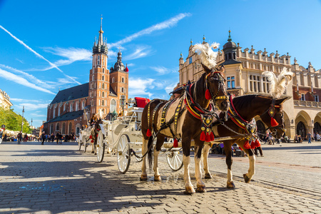
Old Town in Krakow
Kraków's historic Old Town is the pride of Poland.It is one of Central Europe's most beautiful architectural showpieces, and one of the world's most popular tourist destinations. It is full of majestic architectural monuments, priceless cultural treasures, cobbled thoroughfares, atmospheric courtyards, legendary cellar bars and literary cafes,

Slide 3
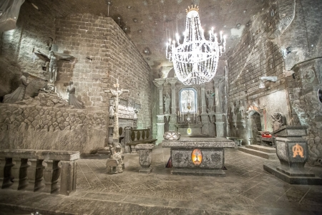
Royal Salt Mines in Wieliczka and Bochnia
The Royal Salt Mines in Wieliczka and Bochnia are one of the oldest rock salt mines in the world and the oldest industrial plants. The historic Wieliczka Salt Mine was inscribed on the UNESCO list in 1978 as one of the first 12 sites in the world. In 2013, the entry was expanded to include the Historic Salt Mine in Bochnia.

